Slide 1

Logistic Regression
Dr. Hemachandran K

Slide 2
Introduction
It produces results in a binary format which is used to predict the outcome of a categorical dependent variable. So, the outcome should be discrete/ categorical such as:
0 or 1
Yes or No
True or False
High or Low

Slide 3
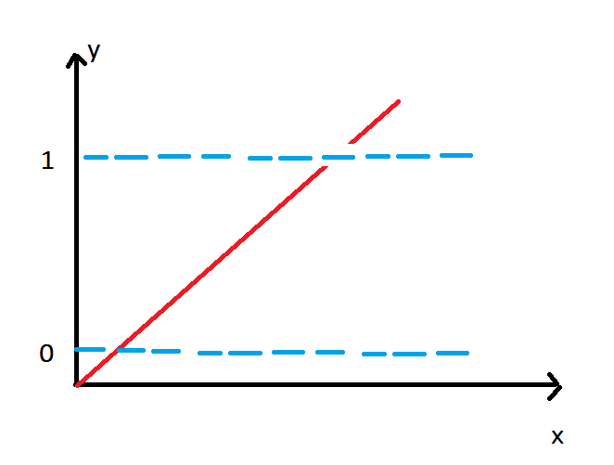

Why not linear regression?
In linear regression the value of Y or the value which you need to predict is in a range.
In logistic regression, we just have two values it can be either 0 or 1. which should not entertain the values below 0 or above 1.
The linear line has to be clipped at 0 and 1 now. So we get curve

Slide 4
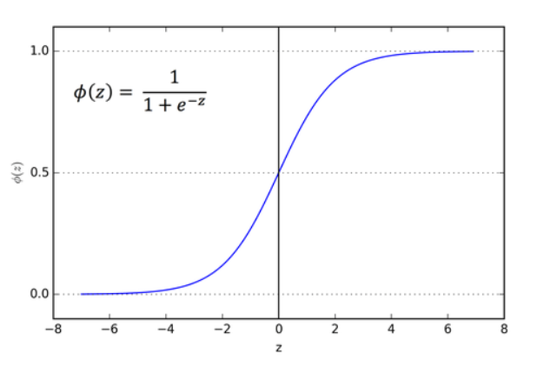
Sigmoid Function
It basically converts any value from -ꝏ to +ꝏ.
Suppose if we have a data point 0.8. so in this how we finalize it whether 1 or 0.
So, here the concept called threshold which basically divides your line. The threshold value indicates the probability of winning (1) or losing(0).

Slide 5
Continues….
If we have 0.8
0.8<threshold is 0 or 0.8 > threshold is 1
The logistic regression equation is derived from the straight line equation
Equation of straight line y = mx+c (1 independent variable)
Suppose if we have more than one independent variable
Y = c +b1x1+b2x2+…. (0 to 1)

Slide 6
Continues….
Lets try to reduce the logistic equation from straight line
Now to get the range of y between 0 and infinity, lets transform y
y/1-y → y=0 then 0
y = 1 then infinity
Lets transform it further, to get range between (-ꝏ to +ꝏ)
Log(y/1-y ) → logistic regression equation

Slide 7
x
Y = mx + c
y = wTx + c
Y = wTx
wTx+b / ||w||
wTx + b
+ve
X x x x
0 0 x x x
0 0 x 0 0
0 0 0 0 0
-ve
X
Case 3
Yi = wTx >0
Yi * Wtx>0
Yi = +ve = +1
Yi = -ve = -1

Slide 8
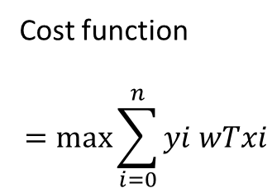
-ve
(+1)(3+3+3+3) +(-1) -(3+3+3+3) -100 -50 - 25= -76
o
O
O
O
+
+
+
+
+ve
100
+
0
Cost function
$$=\max{\sum_{i=0}^{n}{yi wTxi}}$$

